Slide 1
NFT Artwork Auction
Presented by:
Leigh Badua, Loc Thai, Amine Baite, Christopher Diamond, Eunice Huang
Notes:
Amine

Slide 2
Executive Summary
NFT auction application allows digital asset owner registering NFT for auction, public bidding on NFT, and inspector to authenticate NFT via Python, Blockchain and Smart Contract.
Python serves front end communication with users. Blockchain provides benefits of decentralization, distributed architecture, trust, record keeping, and transparency of bidding/asset transfer history. Smart Contract sets a set of rules and allows credible transactions of digital assets without third parties.
The deApp provides trust via decentralized network without central governance and transaction efficiency and transparency of NFT creator/owner exchange history.
Notes:
Amine

Slide 3
Project Approach
Define User Story Identify steps and task coding/testing/integration
Streamlit (Front End)
NFT Bidding
Input: Enter Bid
Output: HexBytes Trx#
NFT Register
Input: Asset info
Output: HexBytes Trx#
SQL (DataStorage)
Data Storage
Blockchain (Python)
Check account balance
sign/send transaction
Send contract/transaction info
Smart Contract (Solidity)
Highest Bid requirement
Credible transaction and asset transfer
Application requirements
Tokenize Property
Notes:
Eunice

Slide 4
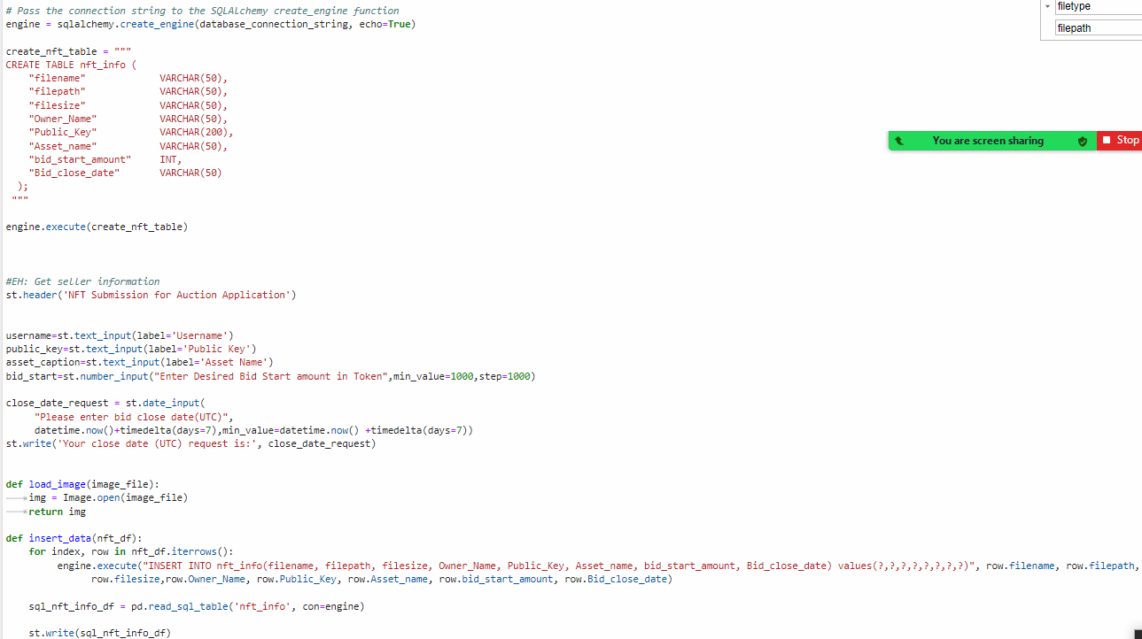
Testing/Evaluating/codes
Notes:
Loc

Slide 5
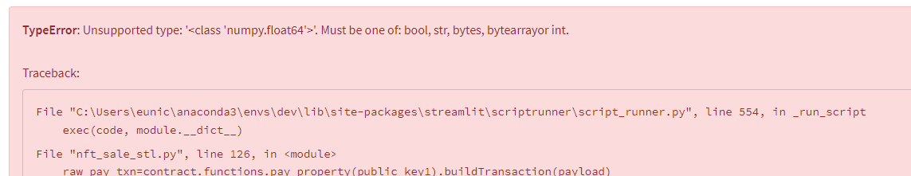
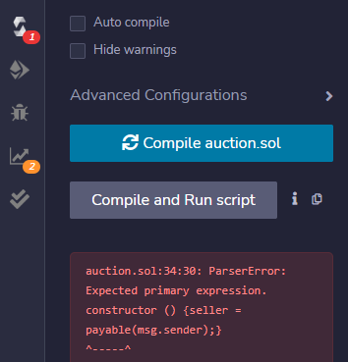
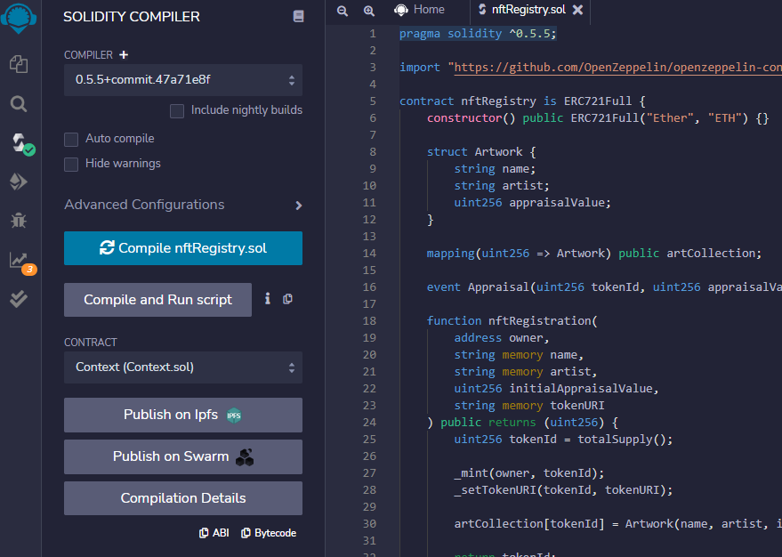
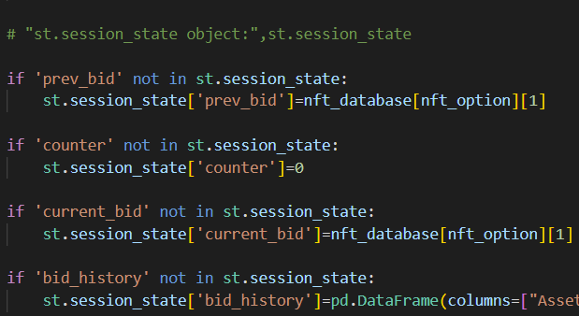
Testing/Evaluating/codes
Streamlit python errors
Smart Contract compiler/Deploy error messages
Notes:
Leigh
Eunice

Slide 6
Demo
Notes:
Loc - NFT submission
Leigh - Bidding
Eunice -Final Approval

Slide 7
Challenges
Streamlit session state between input selections
SQL–datatype, syntax, url address
Solidity, python datatype sync-up issue such int value
Testing through remix, ganache, Metamask, streamlit
Notes:
Chris

Slide 8
Next Step
Take bidder deposit
Monetize platform by taking fee from sales
Use Pinata to store digital asset and release after sale
Final approval requirement in Smart Contract
Notes:
Chris

Slide 9
Thank you

